Slide 1
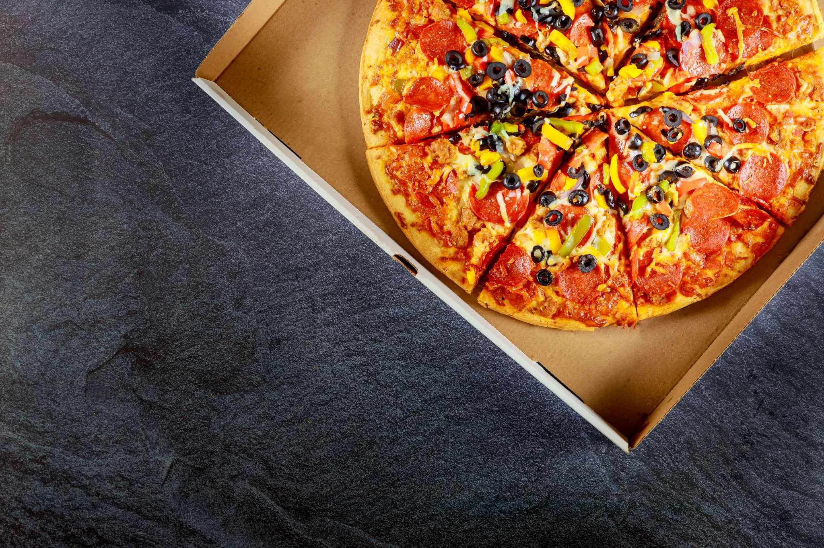
Pizza Ordering App
Enhancing the Pizza Ordering Experience with Flutter and Razorpay API

Slide 2
Group Members:
Sr. No. | Name | Roll No | PRN
1 | Naman Gatpalli | 322023 | 22110337
2 | Prajwal Mahajan | 321042 | 22110401
3 | Harshal Patil | 322048 | 22110409
4 | Sameeksha Hedau | 324023 | 22110353
5 | Yugandhar Patil | 323051 | 22110256
Guide: Prof. Disha Wankhede

Slide 3

Introduction to the project
Pizza Ordering App
Technologies used
Flutter
Razorpay API

Slide 4
Current Features
Overview of current features:
Authentication and login
Selecting Pizzas and ordering
Making payments using Razorpay API
Benefits of current features:
Seamless ordering process
Secure payment transactions

Slide 5
Future Scope
Adding delivery tracking option
Integration of AI to improve user service
Enhanced user experience
Increased transparency in delivery process
Reduced customer anxiety about delivery status

Slide 6
Delivery Tracking Process
How delivery tracking will work:
Integration with third-party delivery APIs
Real-time tracking updates for users
Estimated delivery time display

Slide 7
Technical Implementation
Technical details of implementing delivery tracking:
Integration with Flutter for real-time updates
Utilization of GPS technology for accurate tracking
Backend system for managing delivery data

Slide 8





User Experience Enhancement
How delivery tracking enhances user experience
Visual representation of delivery progress
Notifications for key delivery milestones
Option for user feedback on delivery experience
Comparison with competitors and how the addition of delivery tracking sets your app apart

Slide 9
Conclusion
Project objectives and achievements
Invitation for feedback and suggestions
Contact information for further inquiries
Plans for marketing and promotion to attract more users to the app
Potential partnerships with local pizza chains or delivery services for expanded reach
Along with this, use of AI will further improve user experience by learning user likes and dislikes and showing recommendations accordingly

